Slide 1



Shaping Future India
Mobile Market Pricing & Feature Impact on Buying Decisions

Slide 2
Project
Mobile Market Pricing & Feature Impact on Buying Decisions
SR NO | NAME | ENROLLMENT NO
1. | Bhoomi Modi | 20252013
2. | Meshwa Trivedi | 20252035
3. | Kushagra Mishra | 20251029
4. | Umesh Patel | 20252056
5. | Anish Mishra | 20251005

Slide 3
Project Objective
Analyze Mobile Pricing Trends:
Examine smartphone prices across different brands and models to understand market segmentation and premium vs budget positioning.
Evaluate Feature Impact on Customer Ratings:
Assess how key features such as battery capacity, RAM, storage, camera specifications, and processor type influence customer ratings and satisfaction.
Understand Buying Decision Drivers:
Analyze the relationship between price, features, and user feedback to determine which factors most strongly influence consumer purchasing decisions.
Identify Overpriced and Underpriced Models:
Pinpoint mobile models where high prices do not translate into higher customer ratings, highlighting potential overpricing.

Slide 4
Analytical Workflow (Methodology)
Data Import: By loading the mobile market dataset into Python Jupyter Notebook .
Data Preprocessing: By checking the structure of the dataset and treating missing values .
Sales Volume Analysis: Identify brands with the highest sales volume using the number of customer reviews as a proxy.
Price Analysis (Brand-wise): Compare the average selling price across brands to identify premium and budget segments.
Feature vs Price Relationship: Analyze whether price increases with RAM capacity and other key specifications.
Battery Capacity Impact: Group mobiles by battery capacity (≤4500 mAh, 4501–5000 mAh, >5000 mAh) and compare average customer ratings.

Slide 5
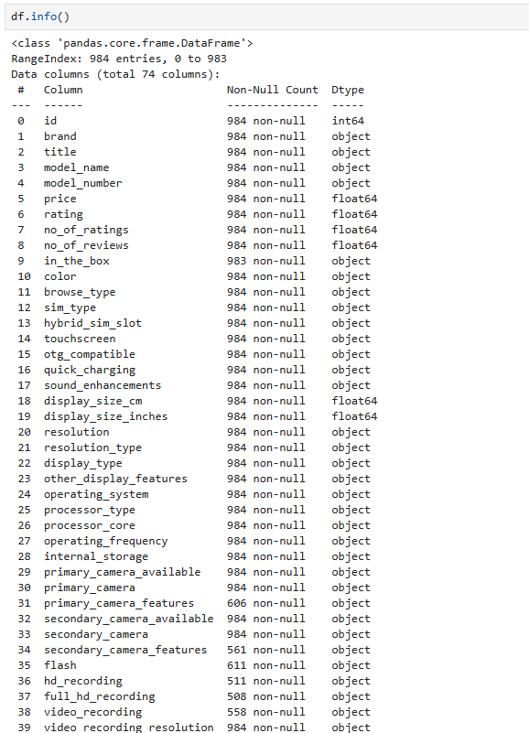
Dataset Overview
The dataset contains
984 mobile phone records
The dataset includes 74 columns,
covering pricing, ratings, reviews,
and detailed technical specifications.

Slide 6
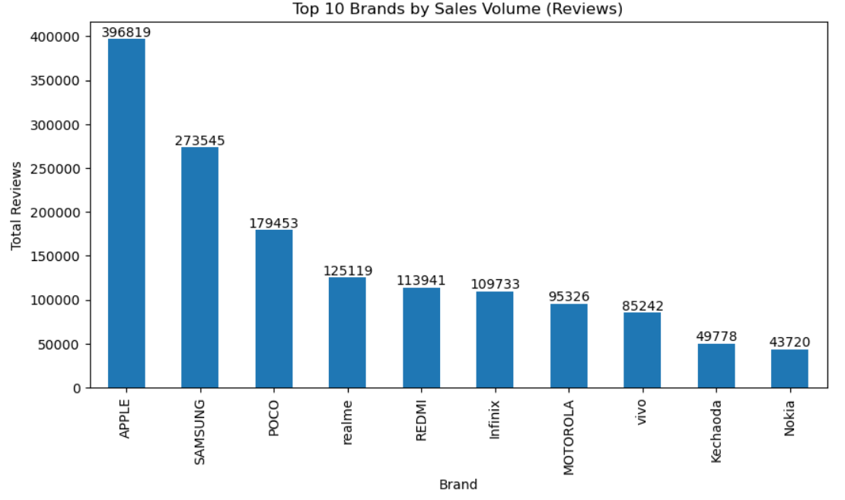
Mobile Market Net Demand Flow
What This Visual Shows
Brands with strong and consistent market demand
Relative dominance of premium vs budget brands
Market leaders versus low-penetration brands.
Key Insights
Apple leads market demand, reflecting strong
brand loyalty.
Samsung maintains broad appeal across
multiple price segments.
POCO and Realme dominate the value-for-money
segment.
Nokia and Kechaoda show lower market traction.

Slide 7
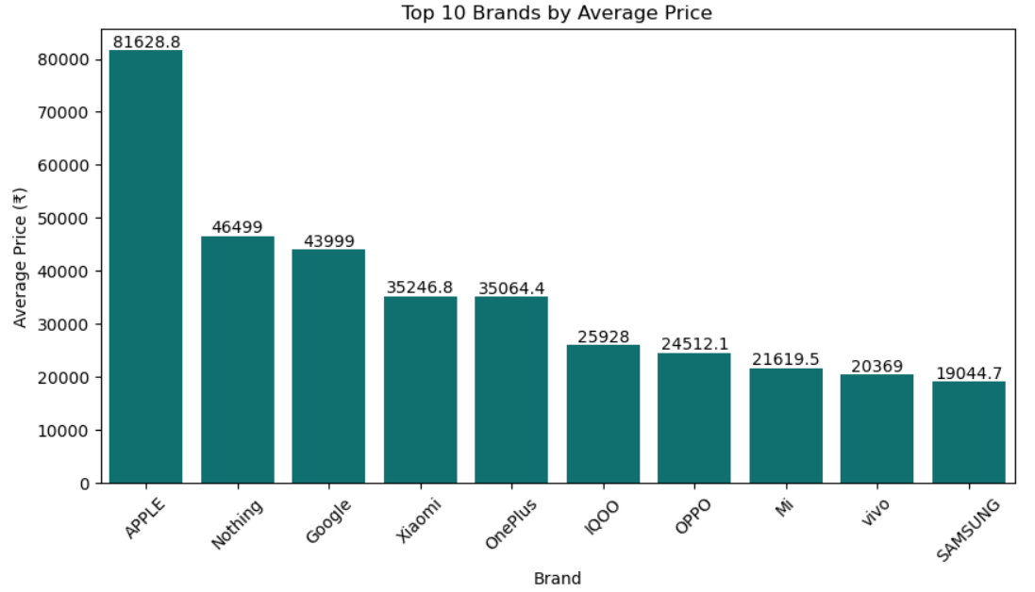
Average Selling Price Across All Brands
What This Visual Shows
This bar chart compares average selling
prices across different mobile brands.
Each bar represents the mean price of
all models offered by a brand.
The visual helps identify premium vs
budget brands in the mobile market.
Key Insights
Apple leads in average price, confirming its premium-
only strategy.
Nothing and Google operate in the higher price
segment compared to most brands.
Xiaomi and OnePlus balance between premium and mid-range offerings.
Samsung, Vivo, Mi, iQOO, and OPPO focus more on affordable and value-driven pricing.

Slide 8
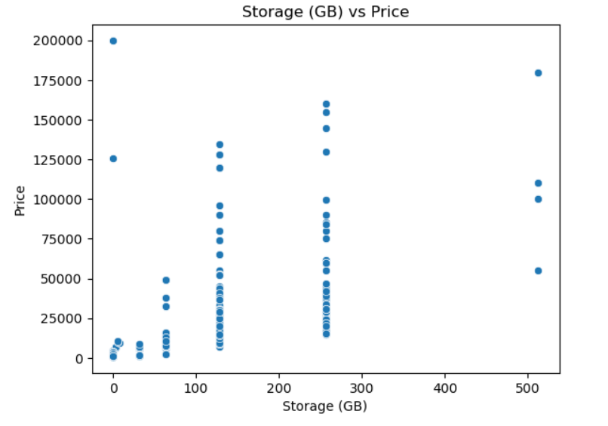
Relationship Between RAM Size And Price
What This Visual Shows
Shows the relationship between mobile storage
capacity (GB) and price.
Each dot represents one mobile phone model.
Key Insights
Phones with higher storage generally cost more.
Phones with the same storage can have very different prices.
Storage affects price, but brand and features also matter.

Slide 9
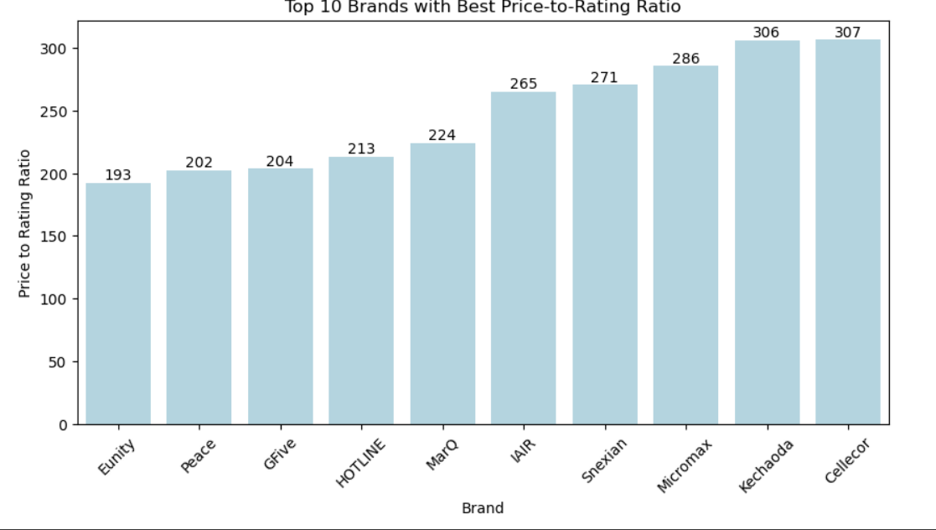
Price-to-Rating Analysis
What This Visual Shows
This bar chart shows the top 10 mobile brands with the lowest price-to-rating ratio.
The price-to-rating ratio is calculated as:
Average Price ÷ Average Rating.
A lower ratio means better value for money, as customers receive higher ratings at a lower price.
The brands are sorted from best value (left) to relatively lower value (right).
Key Insights
Lower price-to-rating ratio indicates better value for money.
Budget and mid-range brands outperform premium brands in value efficiency.
High prices do not guarantee higher customer satisfaction.

Slide 10
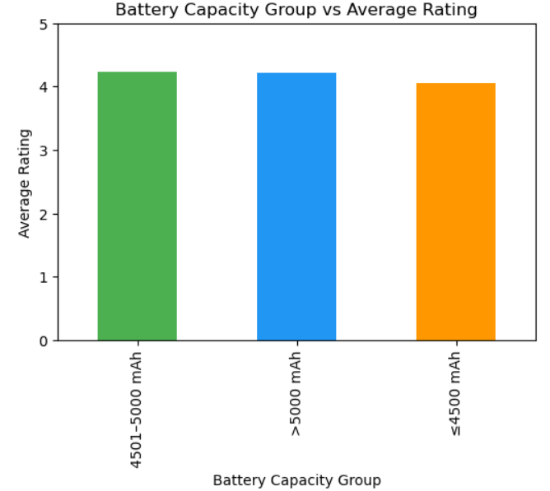
Battery Capacity vs Average Rating
What This Visual Shows
Compares average customer ratings across three battery capacity groups:
≤4500 mAh, 4501–5000 mAh, and >5000 mAh.
Helps identify which battery range delivers the best user satisfaction.
Key Insights
4501–5000 mAh phones receive the highest average ratings.
Very large batteries (>5000 mAh) do not significantly improve ratings.
Smaller batteries (≤4500 mAh) show slightly lower satisfaction.

Slide 11
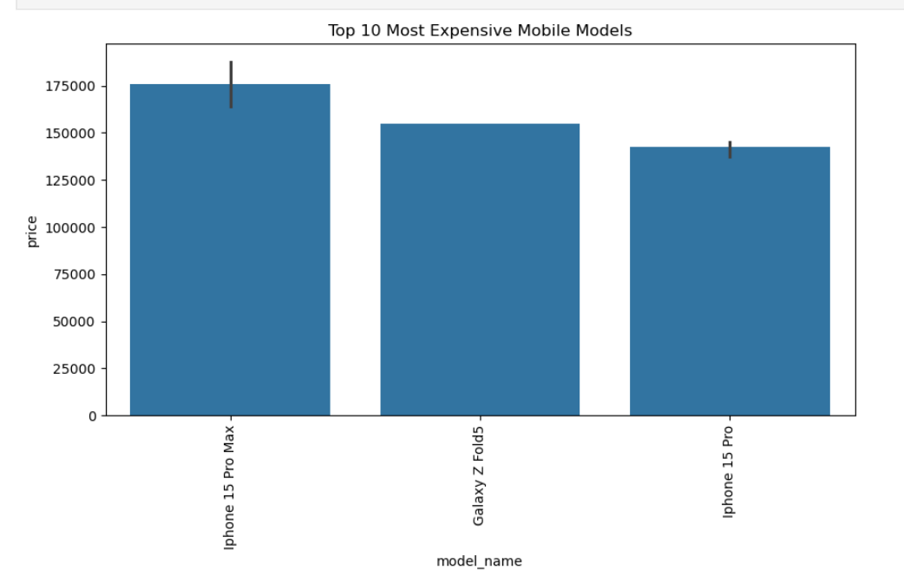
Top 10 Most Expensive Mobile Models
What This Visual Shows
Displays the highest-priced smartphone models
in the market Highlights price differences
within the ultra-premium segment .
Key Insights
iPhone 15 Pro Max leads the premium segment.
Galaxy Z Fold models are highly priced due to
foldable technology.
Flagship prices vary even within premium
brands.

Slide 12
Findings
Apple dominates the premium segment, with the highest average prices and strong customer demand.
Samsung maintains wide market presence, catering to both premium and mid-range segments.
Value-for-money brands (POCO, Realme, Xiaomi) generate high sales volumes despite lower prices.
Higher price does not always translate into higher ratings, indicating a value gap in premium models.
Battery capacity positively influences customer ratings, with larger batteries receiving better feedback.
Customer demand is concentrated among a few leading brands, while smaller brands show limited traction.

Slide 13
Key Learnings
Customer demand can be estimated using review volume when sales data is unavailable.
Price alone does not drive customer satisfaction; features and value matter more.
Premium brands rely on brand perception, while budget brands compete on value.
Battery capacity and core features influence ratings more consistently than price.
Data visualization helps uncover patterns that are not obvious from raw data.
Budget phones succeed when they deliver essential features reliably.
Feature-driven competition is stronger than price-driven competition in the current market.

Slide 14

Thank You
Thank You

